Slide 1
SAP BTP Architect Training
Day 6
Anubhav Oberoy
www.AnubhavTrainings.com
Follow excellence with sheer passion

Slide 2


DISCLAIMER
The training content and delivery of this presentation is confidential, and cannot be recorded, or copied and distributed to any third party, without the written consent of Anubhav Trainings

Slide 3
Agenda – Day 6
01
Create Data Models
02
Working with aspects
03
Translations and CDS views

Slide 4
DB Design
Addresses
1..1
Business partner
(Customers, Suppliers)
1..*
Purchase order
Product Text
(localized)
1..*
1..*
Purchase order Items
1..1
Product

Slide 5

Hands on: Create DB Module
Solution:
https://github.com/soyuztechnologies/SAP_BTP_Training_CLD200/blob/master/Day%203/01%20db.zip

Slide 6
Reuse Types and aspects
When we design database artefacts, at times we have many similar objects and their data types. Instead of hardcoding the type as primitive type, it is recommended to create custom data types. Using custom data type increase reusability and reduce maintenance.
When we create a separate CDS file for reuse purpose and consume it. This file contain types, enumerators and aspects.
Every project would need some common aspects and types related to primary key generation, admin data (created by, created on, changed by, changed on) – temporal, Currency.
Aspect (structures in abap) is combination of many fields.

Slide 7
Introduction to CDS Views
1. Usually we have all our data distributed across multiple tables, and if we need to get this data out, we need to write complex queries with joins. It becomes very complex to handle the maintenance of these large queries. Views will simplify the consumption and make it easy to maintenance.
2. We can perform operations like aggregation on the view.
3. Security
4. CDS views are also the contracts for data consumption
5. They include annotations which drive functionality.
6. View provide lose coupling to load data. Whereas when we use queries and joins, they are always tight coupling.
Exercise:
https://github.com/soyuztechnologies/SAP_BTP_Training_CLD200/blob/master/Day%203/01%20db/01db/CDSViews.cds
Purchase order
Purchase order items
Load what is needed

Slide 8

Hands on: Service creation
Solution
https://github.com/soyuztechnologies/SAP_BTP_Training_CLD200/blob/master/Day%203/02%20srv.zip

Slide 9
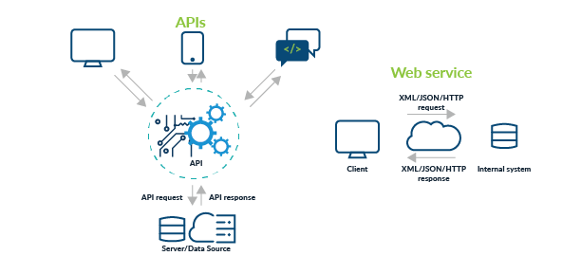
Testing Services in BAS
Exercise:
https://github.com/soyuztechnologies/SAP_BTP_Training_CLD200/blob/master/Day%203/02srv/tester.http

Slide 11

What We Did
Let’s Summarize

Slide 12

www.anubhavtrainings.com
Thank You
End of Day 6

Slide 13


We’re committed to empower you to be
#FutureReady
through powerful training solutions.
We build the workforce of the future.
250+
Corporate Clients
40,000+
Learners Trained
25000+
Learners Placed
FREE WEBINARS
Sign up for free webinars with industry experts every fortnight!
Enroll Now!
Contact us today!
https://anubhavtrainings.com

Slide 14
Agenda – Day 3
01
Understanding Aspects and associations
04
Generic Service handlers
02
05
Working with Service Layer
Introduction to Fiori Elements
04
06
Business Application Studio
Adding UI module

